Slide 1






Mahmoud M. Awali @0xAwali
My Bug Bounty Hunting
Reconnaissance v1.0

Slide 2


Reconnaissance Workflow
attacker
Horizontal Domains
IP Reconnaissance
Subdomains Enumeration
Subdomains Brute Forcing

Slide 3
IP Reconnaissance
attacker
CIDRs Enumeration
IPs Alive
masscan -P443
Reverse DNS Lookup
Full AND Top PORTs Scanning
SAN From Certificates
Third Level Domains

Slide 4
My Methodology
attacker
Collect Information About Your Target By Using whois Command Line e.g.
- Registrant Organization - Registrant Email
root@mine:~#whois company.com

Slide 5
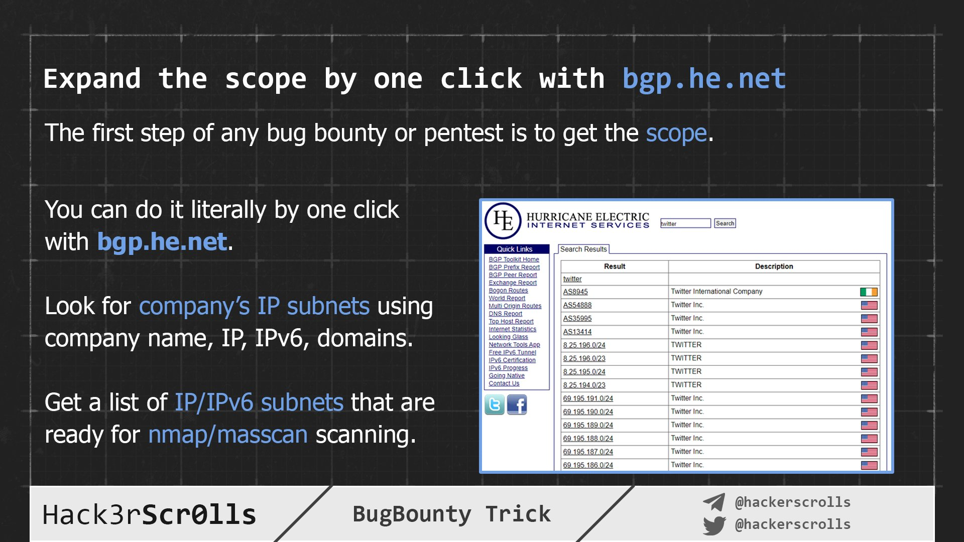

Hack3rScr0lls #BugBounty #BugBountyTip
Tweet

Slide 6
My Methodology
attacker
Use Tools e.g. Asnlookup OR Service host.io To Get List Of CIDR
root@mine:~#python3 asnlookup.py -o Organization
" -o Organization " Name Of Organization To Enumerate

Slide 7
My Methodology
attacker
Use Tools e.g. dnsx To Get Subdomains From Reverse DNS Lookups
root@mine:~#cat cidrs.txt | ./mapcidr -silent -o out.txt root@mine:~#cat out.txt | sort -u | tee -a ips.txt
root@mine:~#cat ips.txt | dnsx -r resolvers.txt -ptr -silent -resp-only | tee -a subdomains.txt
" -r resovers.txt " Input File Of IPs DNS Resolver
" -ptr " Query PTR Record
" -silent " Silent Mode To Show Only Results
" -resp-only " Display Only Response Data

Slide 8
My Methodology
attacker
Use Tools e.g. hakrevdns To Get Subdomains From Reverse DNS Lookups
root@mine:~#cat reverseDNS.sh
#!/usr/bin/env bash
for i in `cat cidrs.txt`
do
prips $i | ./hakrevdns -d -r 1.1.1.1 | tee -a subdomains.txt
done
root@mine:~#./reverseDNS.sh
" prips I.P.v.4/cidr " Print All Of The IP Addresses
" -r 1.1.1.1 " IP Of The DNS Resolver

Slide 9
My Methodology
attacker
Use Tools e.g. masscan To Scan What IPs Have HTTPS Certificate
root@mine:~#masscan -iL ips.txt --source-port 53 --http-user-agent "Mozilla/5.0 (X11; Linux x86_64) AppleWebKit/537.36 (KHTML, like Gecko) Chrome/77" -p 443 -oL httpservice443alive.txt
" -iL input.txt " Reading Input File
" --source-port 53 " Use A Custom Source Port
" --http-user-agent "Mozilla" " Custom User Agent
" -oL httpservice443alive.txt " Output File

Slide 10
My Methodology
attacker
Use Tools e.g. SANextract To Get Subject Alternative Names
root@mine:~#cat httpservice443alive.txt | ./SANextract -timeout 30s | tee -a subdomains.txt

Slide 11
Extract Third Level Domains From List Of Subdomains
attacker
Steps to produce :-
1 - Open Your Terminal
2 - Write This Command
python3 thirdlevel.py subdomains.txt
#!/usr/bin/env python3
import os
import sys
import argparse
parser = argparse.ArgumentParser()
parser.add_argument( "-f","--file",help="file that contains list of subdomains" )
parser.parse_args()
args = parser.parse_args()
if args.file:
if os.path.isfile(args.file):
list_of_subdomains = open( args.file, 'r' )
file_of_subdomains = list_of_subdomains.read().split('\n')
list_of_subdomains.close()
else:
parser.error( '%s file not found' % args.file )
for subdomain in file_of_subdomains :
try :
if subdomain.count(".") == 2 :
print(subdomain)
else :
third_level_domain = subdomain.split(".")[-3] + '.' + subdomain.split(".")[-2] + '.' + subdomain.split(".")[-1]
print(third_level_domain)
except :
sys.exit()
Mine

Slide 12
My Methodology
attacker
Try To Discover What IPs Are Up By Using Tools e.g. nmap To Minimize Time Of Full PORTs Scanning
root@mine:~#nmap -sP -PE -PP -PS21,22,23,25,80,113,31339 -PA80,113,443,10042 --source-port 53 -T4 -iL ips.txt
" -sP " Skip Port Scan
" -PE " Send An ICMP echo Request
" -PP " Send Timestamp And Address Mask
" --source-port 53 " Use A Custom Source Port
" -PSport -PAanotherport " Sends An Empty TCP Packet With The SYN OR TCP ACK Flag Set
" -iL file.txt " Reading The Input From file.txt
" -T4 " Aggressive Mode Speeds Scans

Slide 13
My Methodology
attacker
Full PORTs Scanning With SYN Scan
root@mine:~#nmap -sSV --version-intensity 9 --min-parallelism 64 --min-hostgroup 16 --max-hostgroup 64 --max-retries 3 --min-rate 175 --max-rate 300 -Pn -n --source-port 53 --mtu 24 --data-length 25 --script-args http.useragent="Mozilla/5.0" --max-scan-delay 10 -p- -iL ips.txt -oA output
" -sSV --version-intensity 9 " SYN Scan AND Services Detection Scan
" --min-parallelism 64 " 64 Parallel Tasks
" --max-retries 3 " Number Of Retry Probing Port
" --min-hostgroup 16 --max-hostgroup 64 " Scan Minimum 16 AND Maximum 64 Hosts At One Time
" --mtu 24 " Speciﬁc MTU To The Packet
" --data-length 25 " Append Random Data

Slide 14
My Methodology
attacker
Full PORTs Scanning With SYN Scan II
root@mine:~#nmap -sSV --version-intensity 9 -PN -n --max-rtt-timeout 1000ms --min-parallelism 1000 --max-retries 3 --source-port 53 --mtu 24 --data-length 25 --script-args http.useragent="Mozilla/5.0" -p- -iL ips.txt -oA output
" -sSV --version-intensity 9 " SYN Scan AND Services Detection Scan
" --min-parallelism 1000 " 1000 Parallel Tasks
" --max-retries 3 " Number Of Retry Probing Port
" --max-rtt-timeout 1000ms " Wait 1000 ms Before Timing Out
" --mtu 24 " Speciﬁc MTU To The Packet
" --data-length 25 " Append Random Data

Slide 15
My Methodology
attacker
Top 3674 Ports Scanning With SYN Scan
root@mine:~#nmap -sSV --version-intensity 9 --min-parallelism 64 --min-hostgroup 16 --mtu 24 --max-hostgroup 64 --max-retries 3 --min-rate 175 --max-rate 300 -Pn -n --source-port 53 --data-length 25 --script-args http.useragent="Mozilla/5.0" --max-scan-delay 10 --top-ports 3674 -iL ips.txt -oA output
" --min-rate 175 --max-rate 300 " Nmap will Send Rate Above 175 AND Less 300 packets In Second
" -Pn " Treat All Hosts Are Up
" -n " Never Do DNS Resolution
" --script-args http.useragent="Mozilla/5.0" " Change Default User Agent Header To Mozilla/5.0
" --max-scan-delay 10 " Time Between Probes
" -oA output " Output Files nmap , xml And gnmap

Slide 16
Subdomains Enumeration
attacker
Validation And Filter Wildcard
amass
findomain
subfinder
assetfinder
crtsh
Github Subdomains

Slide 17
My Methodology
attacker
Try To Valid The Third Level Subdomains List By Using dig AND Your Mind
Tweet
Steps to produce :-
1 - Open Your Terminal
2 - Write This Command
dig nonexist.api.comapny.com
3 - If It Is Not Resolvable " NXDOMAIN " That Means :-
api.company.com Is Valid Subdomain
There Are Other Subdomains Under api.comapny.com e.g. exist.api.comapny.com

Slide 18

My Methodology
attacker
Try To Filter The Wildcard Third Level Subdomains List By Using dig AND Your Mind
Blog
Steps to produce :-
1 - Open Your Terminal
2 - Write This Command
dig nonexist.api.comapny.com
dig '*.api.company.com'
3 - If The Two Are Resolvable To Same IP That Means :-
api.company.com Is Wildcard Subdomain
4 - Delete This Subdomain From Third Level Subdomains List

Slide 19
My Methodology
attacker
Use Subfinder To Enumerate List Of Third Level Subdomains
root@mine:~#subfinder -dL list-of-thirdlevel.txt -config config.yaml -all -timeout 90 -silent -o out
" -dL list-of-thirdlevel.txt " List Of Third Level Subdomains e.g. corp.company.com
" -config config.yaml " Configuration File
" -all " Use All Sources For Enumeration
" -timeout 90 " Wait 90 Second Before Timing Out
" -silent " Show Only Subdomains In Output
" -o out " File To Write Output

Slide 20
My Methodology
attacker
Use findomain To Enumerate List Of Third Level Subdomains
root@mine:~#findomain --config file.ini --ua list.txt -f list-of-thirdlevel.txt --http-timeout 90 --quiet -o output.txt
" --config file.ini --ua list.txt " Configuration File And File Containing User Agents Values
" -f list-of-thirdlevel.txt " List Of Third Level Subdomains e.g. corp.company.com
" --http-timeout 90 " Wait 90 Second Before Timing Out
" --quiet " Show Only Subdomains In Output
" -o output.txt " File To Write Output

Slide 21
My Methodology
attacker
Use amass To Enumerate List Of Third Level Subdomains
root@mine:~#amass enum -passive -config file.ini -df list-of-thirdlevel.txt -timeout 90 -silent -o output.txt
" enum -passive " Passively Searching For Subdomains
" -config file.ini " Configuration File
" -timeout 90 " Wait 90 Second Before Timing Out
" -df list-of-thirdlevel.txt " List Of Third Level Subdomains e.g. corp.company.com
" -silent " Show Only Subdomains In Output
" -o output.txt " File To Write Output

Slide 22
My Methodology
attacker
Use assetfinder To Enumerate List Of Specific Fourth Level Subdomains
root@mine:~#cat analysis-output.txt | assetfinder --subs-only | tee -a subdomains.txt
" --subs-only " Display Only Subdomains Of Search Domain

Slide 23
My Methodology
attacker
Use crtsh To Enumerate List Of Specific Fourth Level Subdomains
root@mine:~#cat crtsh-fourthlevel-enumeration.sh
#!/usr/bin/env bash
for i in `cat analysis-output.txt`
do
crtsh -o -q $i | tee -a subdomains.txt
done
root@mine:~#./crtsh-fourthlevel-enumeration.sh
" -o " Display Only Subdomains
" -q " Specific Third Level Domain To Search

Slide 24
My Methodology
attacker
Use github-subdomains.py To Enumerate List Of Specific Fourth Level Subdomains
root@mine:~#cat github-fourthlevel-enumeration.sh
#!/usr/bin/env bash
for i in `cat analysis-output.txt`
do
python3 github-subdomains.py -d $i | tee -a subdomains.txt
done
root@mine:~#./github-fourthlevel-enumeration.sh
" -d " Fourth Level Subdomain For Search

Slide 25
Subdomains Brute Forcing
attacker
* SAN From Certificates
Third Level Subdomains
Analysis-Output
Virtual Host Brute Forcing
Validation And Filter Wildcard
Generate Wordlist
Turbo Intruder
FFUF
Massdns And Dmut

Slide 26
Analysis Output Of IPv4-Reconnaissance AND Subdomains-Enumeration
attacker
Steps to produce :-
1 - Open list-of-subdomains.txt With Text Editor
2 - Grep A Specific Pattern e.g.
api.FUZZ.comapny.com
FUZZ.api.comapny.com
root@mine:~#cat list-of-subdomains.txt
api.corp.company.com
api.test.company.com
dev.api.company.com
test.api.company.com
ini.api.company.com
Mine

Slide 27
Extract Third Level Domains From Output Of Subdomains Enumeration
attacker
Steps to produce :-
1 - Open Your Terminal
2 - Write This Command
python3 thirdlevel.py output.txt
#!/usr/bin/env python3
import os
import sys
import argparse
parser = argparse.ArgumentParser()
parser.add_argument( "-f","--file",help="file that contains list of subdomains" )
parser.parse_args()
args = parser.parse_args()
if args.file:
if os.path.isfile(args.file):
list_of_subdomains = open( args.file, 'r' )
file_of_subdomains = list_of_subdomains.read().split('\n')
list_of_subdomains.close()
else:
parser.error( '%s file not found' % args.file )
for subdomain in file_of_subdomains :
try :
if subdomain.count(".") == 2 :
print(subdomain)
else :
third_level_domain = subdomain.split(".")[-3] + '.' + subdomain.split(".")[-2] + '.' + subdomain.split(".")[-1]
print(third_level_domain)
except :
sys.exit()
Mine

Slide 28
My Methodology
attacker
Try To Valid The Third Level Subdomains List By Using dig AND Your Mind
Tweet
Steps to produce :-
1 - Open Your Terminal
2 - Write This Command
dig nonexist.api.comapny.com
3 - If It Is Not Resolvable " NXDOMAIN " That Means :-
api.company.com Is Valid Subdomain
There Are Other Subdomains Under api.comapny.com e.g. exist.api.comapny.com

Slide 29
My Methodology
attacker
Try To Filter The Wildcard Third Level Subdomains List By Using dig AND Your Mind
Blog
Steps to produce :-
1 - Open Your Terminal
2 - Write This Command
dig nonexist.api.comapny.com
dig '*.api.company.com'
3 - If The Two Are Resolvable To Same IP That Means :-
api.company.com Is Wildcard Subdomain
4 - Delete This Subdomain From Third Level Subdomains List

Slide 30
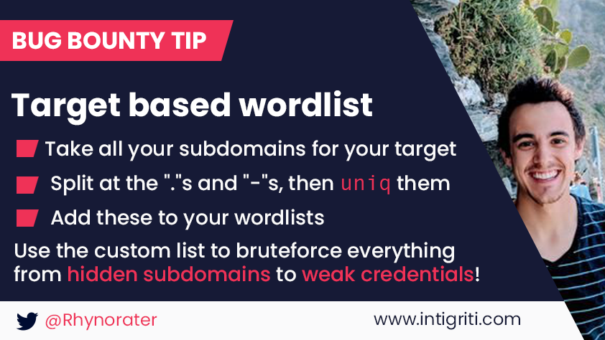
My Methodology
attacker
Generate Your Wordlist e.g. cat Subdomains.txt | sed 's/\./\n/g' | sort -u | tee -a words.txt
Tweet

Slide 31
Generate Wordlist Of Subdomains To Resolve Based On Analysis Output
attacker
Steps to produce :-
1 - Open Your Terminal
2 - Write This Command
./generate-wordlist.sh
root@mine:~#cat genearet-wordlist.sh
#!/usr/bin/env bash
for i in `cat analysis-output..txt`
do
for j in `cat words.txt`
do
echo "$i" | sed "s/FUZZ/$j/g" | tee -a $i.txt
done
done
root@mine:~#./genearet-wordlist.sh
Mine

Slide 32
Generate Wordlist Of Subdomains To Resolve Based On Words Of Domains
attacker
Steps to produce :-
1 - Open Your Terminal
2 - Write This Command
./generate-wordlist.sh
root@mine:~#cat genearet-wordlist.sh
#!/usr/bin/env bash
for i in `cat thirdlevel-subdomains-list.txt`
do
for j in `cat words.txt`
do
echo "$j.$i" | tee -a $i.txt
done
done
root@mine:~#./genearet-wordlist.sh
Mine

Slide 33
My Methodology
attacker
Use Tools e.g. subgen To Generate Wordlist Based On Names Of Subdomains
root@mine:~#cat genearet-wordlist.sh
#!/usr/bin/env bash
for i in `cat thirdlevel-subdomains-list.txt`
do
cat common-words-e.g.-corp-test-dev-internal-etc.txt | subgen -d "$i" | tee -a $i.txt
done
root@mine:~#./genearet-wordlist.sh
" -d "api.company.com" " Name Of Third Level Subdomains To Generate Similar Pattern

Slide 34
My Methodology
attacker
Use Tools e.g. dnsvalidator OR fresh.py With massdns To Resolve These Subdomains To IPs
root@mine:~#cat resolve.sh
#!/usr/bin/env bash
python3 fresh.py -o checking.txt
dnsvalidator -tL checking.txt -threads 20 -o resolvers.txt
./bin/massdns -r resolvers.txt -t A -o S -w output.txt subdomains-to-resolve.txt
root@mine:~#./resolve.sh
" -r resolvers.txt " List Of DNS Servers IPs
" -o S -w output.txt " Normal Output Into Text File

Slide 35
My Methodology
attacker
Use Tools e.g. dumt To Perform Permutations And Mutations etc And Brute Force The Result
root@mine:~#dmut --workers 100 -d common-words.txt --dns-retries 5 --dnsFile resolvers.txt --dns-errorLimit 50 --dns-timeout 3000 --show-stats --output results.txt
" -d words.txt " Common Words To Permute etc
" --dns-retries 5 " Try 5 Times In Failed Queries
" --dns-errorLimit 50 " 50 Errors To Disable DNS
" --dns-timeout 3000 " Wait 3 Second To Time Out

Slide 36
My Methodology
attacker
Use Tools e.g. SANextract To Get * In Subject Alternative Names
root@mine:~#cat httpservice443alive.txt | ./SANextract -timeout 30s -json | tee -a vhosts.json
root@mine:~#cat vhosts.json | grep "*" | tee -a virtual-host-scanning.json

Slide 37

My Methodology
attacker
FUZZ The Host Header e.g. Host: FUZZ.company.com To Get Internal Hosts By Using FFUF OR Turbo Intruder
Slides
GET / HTTP/1.1 Host: FUZZ.company.com
User-Agent: Mozilla/5.0
Referer: https://previous.com/path
Origin: https://www.company.com
Tweet

Slide 38
My Methodology
attacker
root@mine:~#ffuf -u https://I.P.v.4/ -H "Host: FUZZ.company.com" -w wordlist.txt -c -mc 200 -fr "Your-Regex" -timeout 30 -s -replay-proxy http://localhost:8080
" -url URL " URL Of Target e.g. https://www.company.com
" -H "Host: FUZZ.company.com" " Fuzz Host Header To Get Subdomains Under company.com
" -w wordlist.txt " Path To The Wordlist
" -c " Colorize Output
" -mc 200 " Match 200 OK HTTP status code
" -fr "Regex" " Filter This Pattern
" -timeout 30 " Wait 30 Second Before Timing Out
" -s " Silent Mode
" -replay-proxy http://localhost:8080 " Send Only Unfiltered Requests Through A Replay Proxy

Slide 39
FUZZ Host Header By Using Turbo Intruder
attacker
Steps to produce :-
1 - Sent Request To Turbo Intruder
2 - Add %s In Host Header e.g. Host: %s.company.com
3 - Click Attack
4 - Filter Your Result
root@mine:~#cat file-of-turbo-intruder.py
def queueRequests(target, wordlists):
engine = RequestEngine(endpoint=target.endpoint,
concurrentConnections=100,
requestsPerConnection=100,
pipeline=True
)
for word in open('/path/wordlist'):
engine.queue(target.req, word.rstrip())
def handleResponse(req, interesting):
if 'HTTP' in req.response:
table.add(req)
Mine

Slide 40
Horizontal Domains
attacker
Copyright And Analytics ID
Acquisitions
whoxy
crtsh
Third Level Subdomains
assetfinder

Slide 41
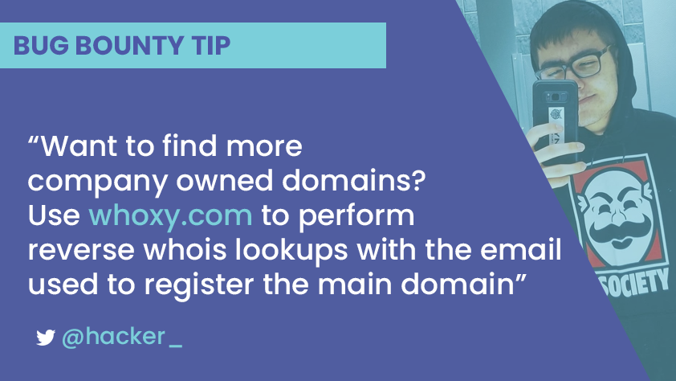
My Methodology
attacker
Enumerate Related Domains By Using Registrant Email python3 domain-finder.py --key API-Key -d company.com
Tweet
Tweet

Slide 42

My Methodology
attacker
Google
site:acquiredby.co company
Google Search
I’m Feeling Lucky

Slide 43
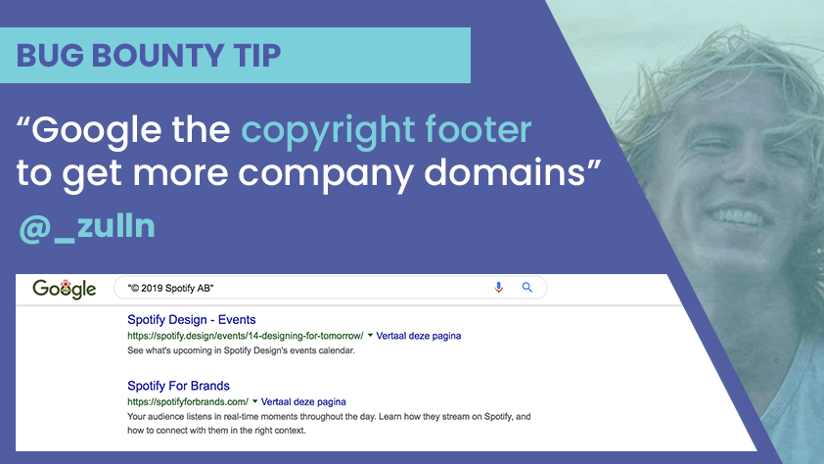
My Methodology
attacker
Enumerate Related Domains By Using Copyright Mark
Tweet

Slide 44
My Methodology
attacker
Google
"© 2020 company" "© company 2020"
Google Search
I’m Feeling Lucky

Slide 45
My Methodology
attacker
Try To Enumerate Related Domains By Using Google Analytics ID
Tweet
Steps to produce :-
1 - Open Your Terminal
2 - Write This Command
curl -s https://www.company.com | grep 'ga("create"'
3 - Copy Google Analytics ID e.g. UA-*******-**
4 - Visit This URL
site-overview.com/website-report-search/analytics-account-id/ID
5 - Change Google Analytics ID Without UA- To ID

Slide 46
My Methodology
attacker
Reverse Analytics Search
company.com OR UA-11040216
Search Analytics ID or Domain

Slide 47
My Methodology
attacker
Use crtsh To Enumerate Subdomains
root@mine:~#cat crtsh-subdomains-enumeration.sh
#!/usr/bin/env bash
for i in `cat related-domains-output.txt`
do
crtsh -o -q $i | tee -a related-subdomains.txt
done
root@mine:~#./crtsh-subdomains-enumeration.sh
" -o " Display Only Subdomains
" -q " Specific Related Domain To Search

Slide 48
Extract Third Level Domains From List Of Subdomains
attacker
Steps to produce :-
1 - Open Your Terminal
2 - Write This Command
python3 thirdlevel.py related-subdomains.txt
#!/usr/bin/env python3
import os
import sys
import argparse
parser = argparse.ArgumentParser()
parser.add_argument( "-f","--file",help="file that contains list of subdomains" )
parser.parse_args()
args = parser.parse_args()
if args.file:
if os.path.isfile(args.file):
list_of_subdomains = open( args.file, 'r' )
file_of_subdomains = list_of_subdomains.read().split('\n')
list_of_subdomains.close()
else:
parser.error( '%s file not found' % args.file )
for subdomain in file_of_subdomains :
try :
if subdomain.count(".") == 2 :
print(subdomain)
else :
third_level_domain = subdomain.split(".")[-3] + '.' + subdomain.split(".")[-2] + '.' + subdomain.split(".")[-1]
print(third_level_domain)
except :
sys.exit()
Mine

Slide 49
My Methodology
attacker
Use assetfinder To Enumerate List Of Third Level Subdomains
root@mine:~#cat third-level-subdomains.txt | assetfinder --subs-only | tee -a all-subdomains.txt
" --subs-only " Display Only Subdomains Of Search Domain

Slide 50
Mahmoud M. Awali @0xAwali
Thank You

